Slide 1
JavaScript Essentials
Events and Listeners

Slide 2
Table of Contents
Events
Using Web Events
Event objects
Prevent default Events behaviors
Event Bubbling vs Event Capturing
Event Delegation

Slide 3

Lesson Objectives
Understand the fundamental theory of events, how they work in browsers, and how events may differ in different programming environments
Able to handle Event using inline event handler or addEventListener() method
Able to capture user input using Event handler
Combine with Selector API to create interactive web app

Slide 4
Events
Section 1

Slide 5
Events
Events are actions or occurrences that happen in the system you are programming, which the system tells you about so you can respond to them in some way if desired.
For example: if the user clicks a button on a webpage, you might want to respond to that action by displaying an information box.

Slide 6
Events - Example
In airport when the runway is clear for a plane to take off, a signal is communicated to the pilot, and as a result, they commence piloting the plane.

Slide 7
Events
In the case of the Web, events are fired inside the browser window, and tend to be attached to a specific item that resides in it
There are a lot of different types of events that can occur, for example:
The user clicking the mouse over a certain element or hovering the cursor over a certain element.
The user pressing a key on the keyboard.
The user resizing or closing the browser window.
A web page finishing loading.
A form being submitted.
A video being played, or paused, or finishing play.
An error occurring.
Notes:
You can gather from this (and from glancing at the MDN Event reference) that there are a lot of events that can be responded to.

Slide 8
Event Handler
Each available event has an event handler, which is a block of code (usually a JavaScript function that you as a programmer create) that will be run when the event fires.
When such a block of code is defined to be run in response to an event firing, we say we are registering an event handler.
Note: that event handlers are sometimes called event listeners
Notes:
You can gather from this (and from glancing at the MDN Event reference) that there are a lot of events that can be responded to.
Note: Web events are not part of the core JavaScript language — they are defined as part of the APIs built into the browser.
— they are pretty much interchangeable for our purposes, although strictly speaking, they work together. The listener listens out for the event happening, and the handler is the code that is run in response to it happening.

Slide 9
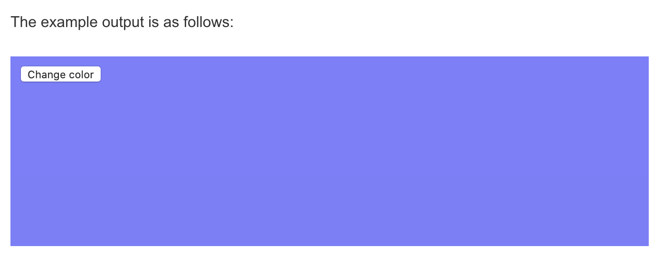
Events – Demo 1
Notes:
Every time user click on button the background color of the page is changed randomly

Slide 10
Events – Summary
Events are actions or occurrences that happen in the system you are programming
Events are fired inside the browser window, and tend to be attached to a specific item that resides in it
Each available event has an event handler
Web events are not part of the core JavaScript language — they are defined as part of the APIs built into the browser

Slide 11
Using Web Events
Section 2

Slide 12
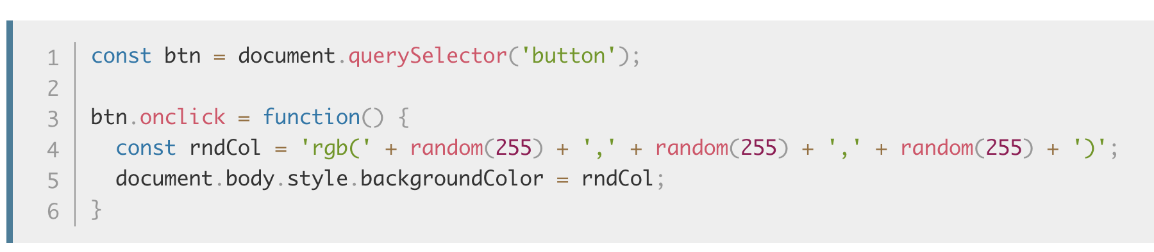
Using Web Events - Event handler properties
There are a number of ways in which you can add event listener code to web pages so that it will be run when the associated event fires.
These are the properties that exist to contain event handler code that we have seen most frequently during the course:
Notes:
Check Demo 2

Slide 13
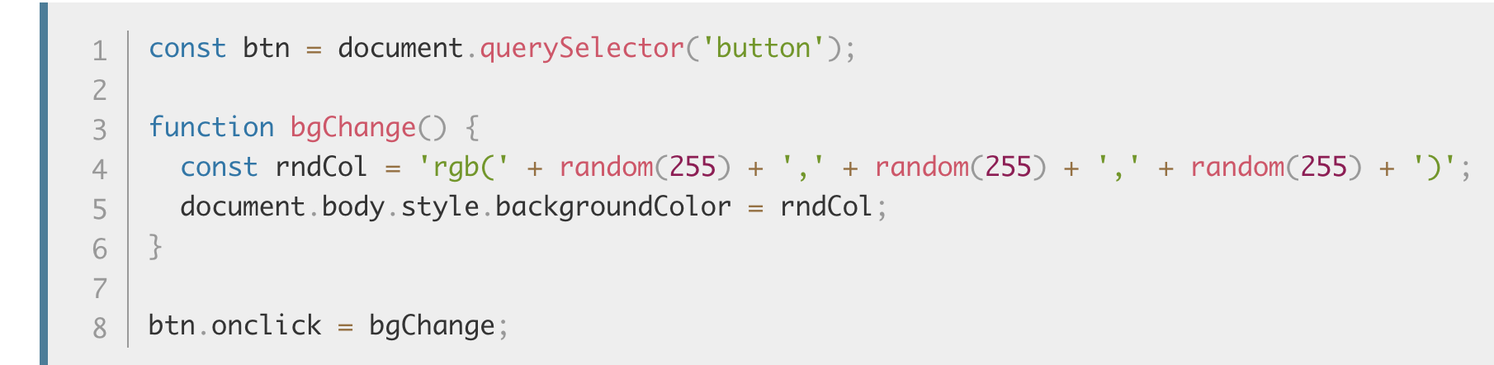
Using Web Events - Event handler properties
The onclick property is the event handler property being used in this situation.
It is essentially a property like any other available on the button (e.g. btn.textContent, or btn.style), but it is a special type — when you set it to be equal to some code, that code is run when the event fires on the button.
You could also set the handler property to be equal to a named function name.
The following would work just the same:
Notes:
The onclick property is the event handler property being used in this situation. It is essentially a property like any other available on the button (e.g. btn.textContent, or btn.style), but it is a special type — when you set it to be equal to some code, that code is run when the event fires on the button.

Slide 14
Using Web Events – Practice 1
Changes the color when the button is focused and unfocused. Try pressing tab to focus on the button and press tab again to focus away from the button (Hints: btn.onfocus, btn.onblur)
Changes the color only when the button is double-clicked (Hints: btn.ondblclick)
Changes the color when a key is pressed on the keyboard (Hints: document.onkeypress)
Changes the color when the mouse pointer is moved so it begins hovering over the button, or when pointer stops hovering over the button and moves off of it, respectively (Hints: btn.onmouseover, btn.onmouseout)

Slide 15
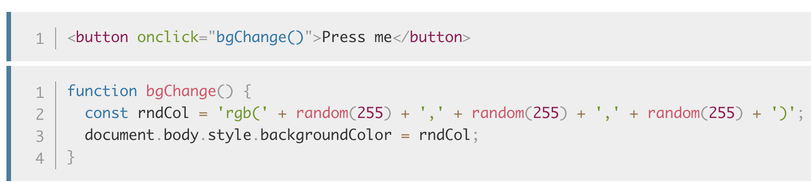
Using Web Events - Inline Event handler
You might also see a pattern like this in your code:

Slide 16
Using Web Events - Inline Event handler
The earliest method of registering event handlers found on the Web involved event handler HTML attributes (or inline event handlers)
You could also insert JavaScript directly inside the attribute, for example:

Slide 17
Using Web Events - Inline Event handler
You can find HTML attribute equivalents for many of the event handler properties; however, you shouldn't use these — they are considered bad practice.
It might seem easy to use an event handler attribute if you are just doing something really quick, but they very quickly become unmanageable and inefficient.
For a start, it is not a good idea to mix up your HTML and your JavaScript, as it becomes hard to read/understand

Slide 18
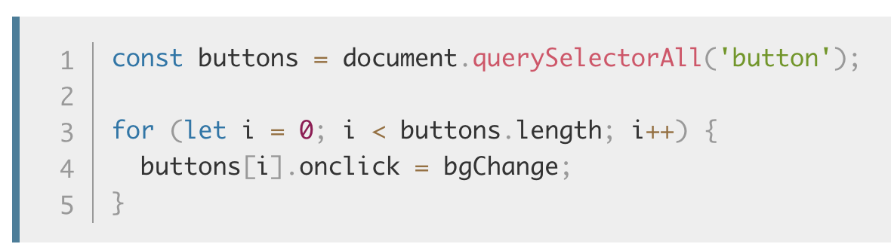
Using Web Events - Inline Event handler
Even in a single file, inline event handlers are not a good idea. One button is OK, but what if you had 100 buttons?
With JavaScript, you could easily add an event handler function to all the buttons on the page no matter how many there were, using something like this:

Slide 19
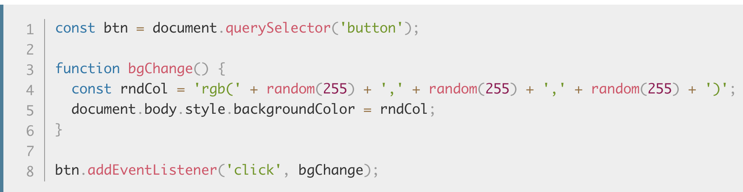
Using Web Events – addEventListener()
The newest type of event mechanism is defined in the Document Object Model (DOM) Level 2 Events Specification, which provides browsers with a new function — addEventListener().
This functions in a similar way to the event handler properties, but the syntax is obviously different:
Notes:
Check Demo 1

Slide 20
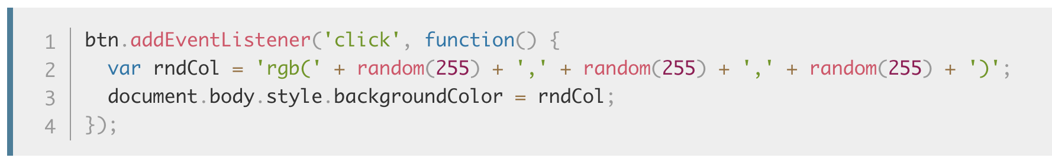
Using Web Events – addEventListener()
Inside the addEventListener() function, we specify two parameters — the name of the event we want to register this handler for, and the code that comprises the handler function we want to run in response to it.
Note that it is perfectly appropriate to put all the code inside the addEventListener() function, in an anonymous function, like this:

Slide 21
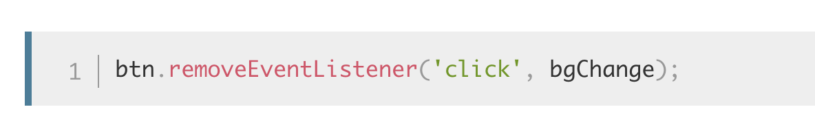
Using Web Events – addEventListener()
This mechanism has some advantages over the older mechanisms discussed earlier.
For a start, there is a counterpart function, removeEventListener(), which removes a previously added listener.
For example, this would remove the listener set in the first code block in this section:
Notes:
Remove event handler for click events

Slide 22
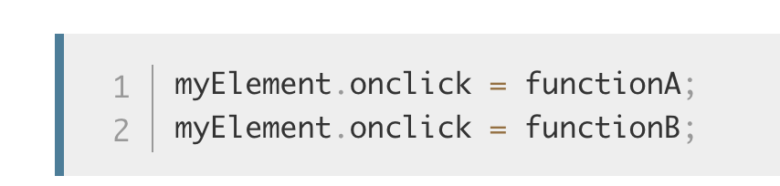
Using Web Events – addEventListener()
This isn't significant for simple, small programs, but for larger, more complex programs it can improve efficiency to clean up old unused event handlers.
Second, you can also register multiple handlers for the same listener. The following two handlers wouldn't both be applied:

Slide 23
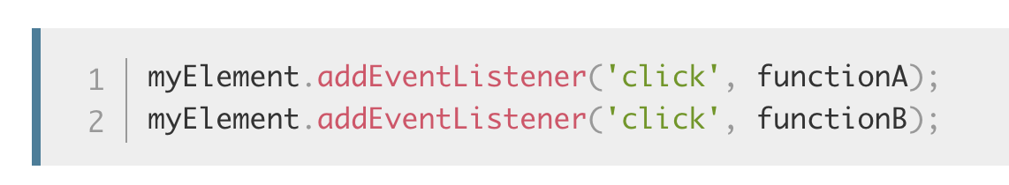
Using Web Events – addEventListener()
The second line overwrites the value of onclick set by the first line. This would work, however:
Both functions would now run when the element is clicked.

Slide 24
Using Web Events – What mechanism to use?
Of the three mechanisms, you definitely shouldn't use the HTML event handler attributes — these are outdated, and bad practice, as mentioned above.
The other two are relatively interchangeable, at least for simple uses:
Event handler properties have less power and options, but better cross-browser compatibility (being supported as far back as Internet Explorer 8). You should probably start with these as you are learning.
DOM Level 2 Events (addEventListener(), etc.) are more powerful, but can also become more complex and are less well supported (supported as far back as Internet Explorer 9). You should also experiment with these, and aim to use them where possible.

Slide 25
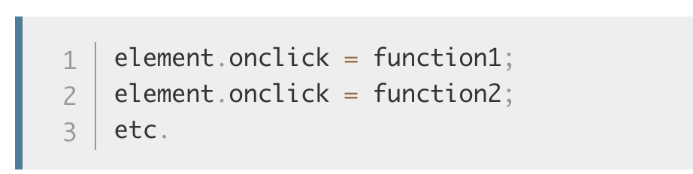
Using Web Events – What mechanism to use?
The main advantages of the third mechanism are that you can remove event handler code if needed, using removeEventListener(), and you can add multiple listeners of the same type to elements if required

Slide 26
Using Web Events - Overview
There are three ways you can use to handle Event in Web: Inline handler, Handler properties and addEventListener()
Definitely shouldn't use the inline event handler attributes — these are outdated, and bad practice
The other two are relatively interchangeable
For now, use addEventListener()

Slide 27
Events object
Section 3

Slide 28
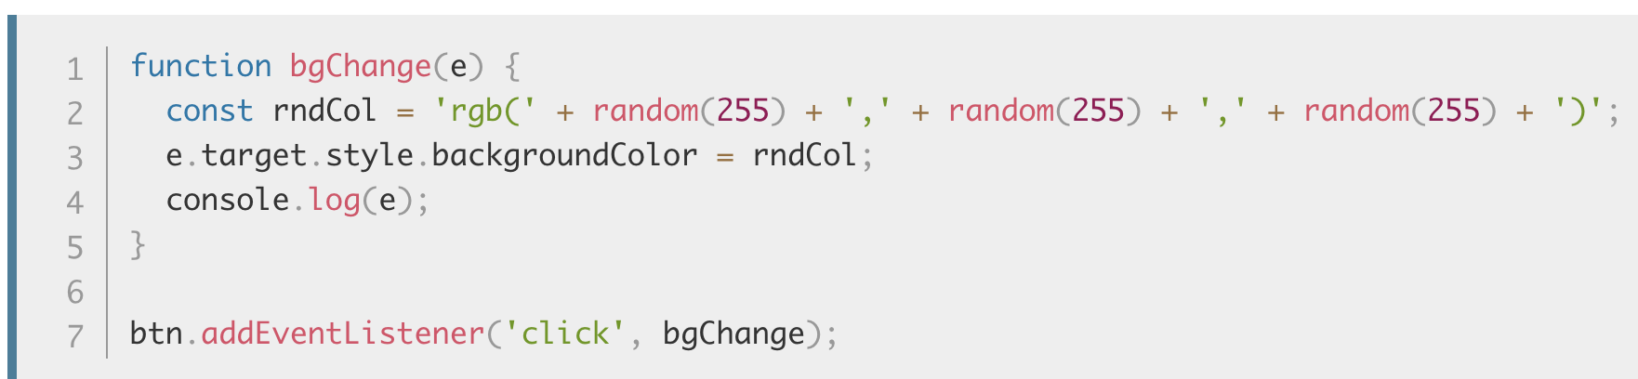
Events object
Sometimes inside an event handler function, you might see a parameter specified with a name such as event, evt, or simply e.
This is called the event object, and it is automatically passed to event handlers to provide extra features and information:

Slide 29
Events object
e.target is incredibly useful when you want to set the same event handler on multiple elements and do something to all of them when an event occurs on them.
Check Unit 11 – Demo 4: we use e.target to selector the clicked element without using querySelector

Slide 30
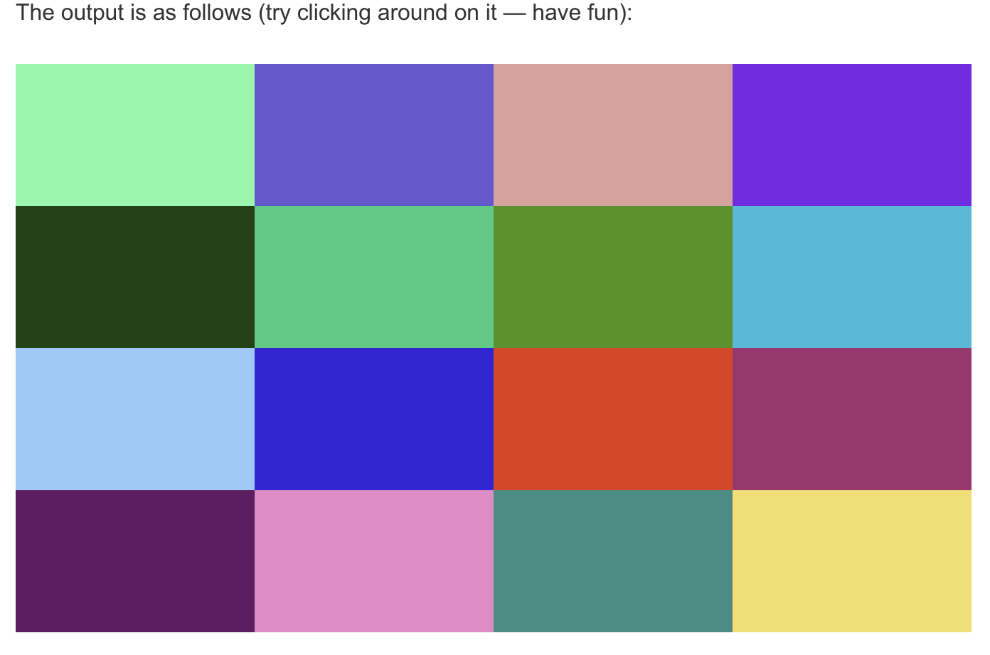
Events object – Practice time

Slide 31
Events object – Prevent default behavior
Sometimes, you'll come across a situation where you want to prevent an event from doing what it does by default.
Check Unit 11 – Demo 5: common example is that of a web form, for example, a custom registration form.
We want to add validation to it and don’t want the page to be reloaded
Notes:
Demo 5

Slide 32
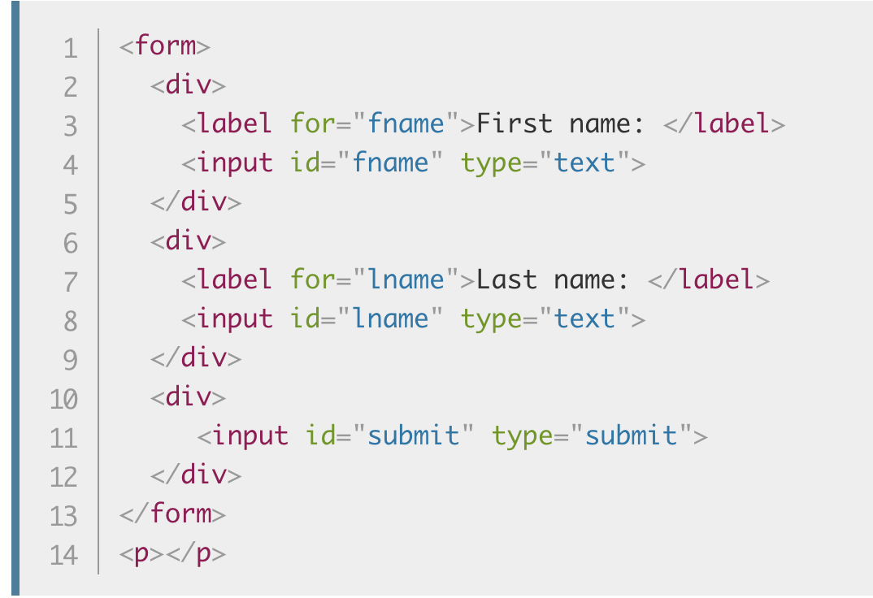
Events object – Prevent default behavior
First, a simple HTML form that requires you to enter your first and last name:
Notes:
Check Unit 11 – Demo 5

Slide 33
Events object – Event bubbling and capture
The final subject to cover here is something that you won't come across often, but it can be a real pain if you don't understand it.
Event bubbling and capture are two mechanisms that describe what happens when two handlers of the same event type are activated on one element.
Check Unit 11 – Demo 6
When you click the video it starts to play, but it causes the <div> to also be hidden at the same time.
This is because the video is inside the <div> — it is part of it — so clicking on the video actually runs both the event handlers.

Slide 34
Events object – Event bubbling and capture
When an event is fired on an element that has parent elements (in this case, the <video> has the <div> as a parent), modern browsers run two different phases — the capturing phase and the bubbling phase.
In the capturing phase:
The browser checks to see if the element's outer-most ancestor (<html>) has an onclick event handler registered on it for the capturing phase, and runs it if so.
Then it moves on to the next element inside <html> and does the same thing, then the next one, and so on until it reaches the element that was actually clicked on.

Slide 35
Events object – Event bubbling and capture
In the bubbling phase, the exact opposite occurs:
The browser checks to see if the element that was actually clicked on has an onclick event handler registered on it for the bubbling phase, and runs it if so.
Then it moves on to the next immediate ancestor element and does the same thing, then the next one, and so on until it reaches the <html> element.

Slide 36
Events object – Event bubbling and capture

Slide 37
Events object – Event bubbling and capture
In modern browsers, by default, all event handlers are registered for the bubbling phase.
So in our current example, when you click the video, the click event bubbles from the <video> element outwards to the <html> element.
Along the way:
It finds the video.onclick... handler and runs it, so the video first starts playing.
It then finds the videoBox.onclick... handler and runs it, so the video is hidden as well.
In cases where both types of event handlers are present, bubbling and capturing, the capturing phase will run first, followed by the bubbling phase.

Slide 38
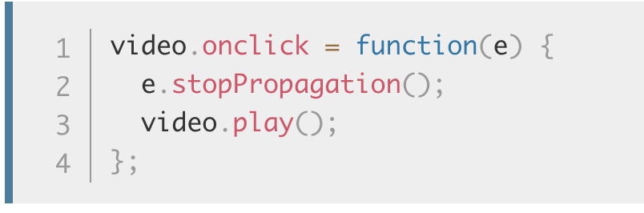
Events object – Event bubbling and capture
This is annoying behavior, but there is a way to fix it! The standard Event object has a function available on it called stopPropagation() which, when invoked on a handler's event object, makes it so that first handler is run but the event doesn't bubble any further up the chain, so no more handlers will be run.
We can, therefore, fix our current problem by changing the second handler function in the previous code block to this

Slide 39
Events object – Event bubbling and capture
Why bother with both capturing and bubbling? Well, in the bad old days when browsers were much less cross-compatible than they are now, Netscape only used event capturing, and Internet Explorer used only event bubbling.
When the W3C decided to try to standardize the behavior and reach a consensus, they ended up with this system that included both, which is the one modern browsers implemented.
As mentioned above, by default all event handlers are registered in the bubbling phase, and this makes more sense most of the time. If you really want to register an event in the capturing phase instead, you can do so by registering your handler using addEventListener(), and setting the optional third property to true.

Slide 40
Events object – Event bubbling and capture
Bubbling also allows us to take advantage of event delegation — this concept relies on the fact that if you want some code to run when you click on any one of a large number of child elements, you can set the event listener on their parent and have events that happen on them bubble up to their parent rather than having to set the event listener on every child individually.
A good example is a series of list items — if you want each one of them to pop up a message when clicked, you can set the click event listener on the parent <ul>, and events will bubble from the list items to the <ul>.
Notes:
This concept is explained further on David Walsh's blog, with multiple examples — see How JavaScript Event Delegation Works.

Slide 41
Events object – Practice time
Practice Events object
Create a slide show app with 2 button: Next and Previous.
Everytime user click Next show next image in array.
If user click Previous show previous image.
Search for image in Google Images
Notes:
P1:

Slide 42
Events Object - Overview
Event object it is automatically passed to event handlers to provide extra features and information
The target property of the event object is always a reference to the element that the event has just occurred upon
e.target is incredibly useful when you want to set the same event handler on multiple elements and do something to all of them when an event occurs on them
Use event.preventDefault() method to prevent an event from doing what it does by default
Modern Browser supports Event capturing and Event bubbling mode (default)
Take advantage of Event Delegation to write less code but do more task

Slide 43

Thank you
Q&A

